Slide 1


SWARNANDHRA
College of Engineering and Technology
( Autonomous )
( Permanent Affiliated to JNTUK, Kakinada, Approved by AICTE )
Department of Computer Science and Engineering
HEART DISEASE PREDICTION USING MACHINE LEARNING
Team Members
Mr. M. SOHATEJ NAGA KISHORE (20A21A05A7)
Mr. K. HEMANTH SAI PAVAN TEJA (20A21A05A4)
Mrs. T. INDU NAGA RUKMINI (21A25A0512)
Mrs. K. PRANEETHA (20A21A0589)
Mrs. K. SRI SHANMUKHI (20A21A0567)
Project Coordinator
Under the guidance of
Mr. K. Rajesh Kumar
Associate Professor, Department of CSE
Mr. N. Tulasi Raju
Associate Professor, Department of CSE

Slide 2
content
INTRODUCTION
ABSTRACT
PROBLEM STATEMENT
EXISTING SYSTEM
PROPOSED SYSTEM
SYSTEM REQUIREMENTS SPECIFICATION
ARCHITECTURE
UML DIAGRAM
ALGORITHM
SCREEN SHORTS
FUTURE ENHANCEMENT
CONCLUSION

Slide 3
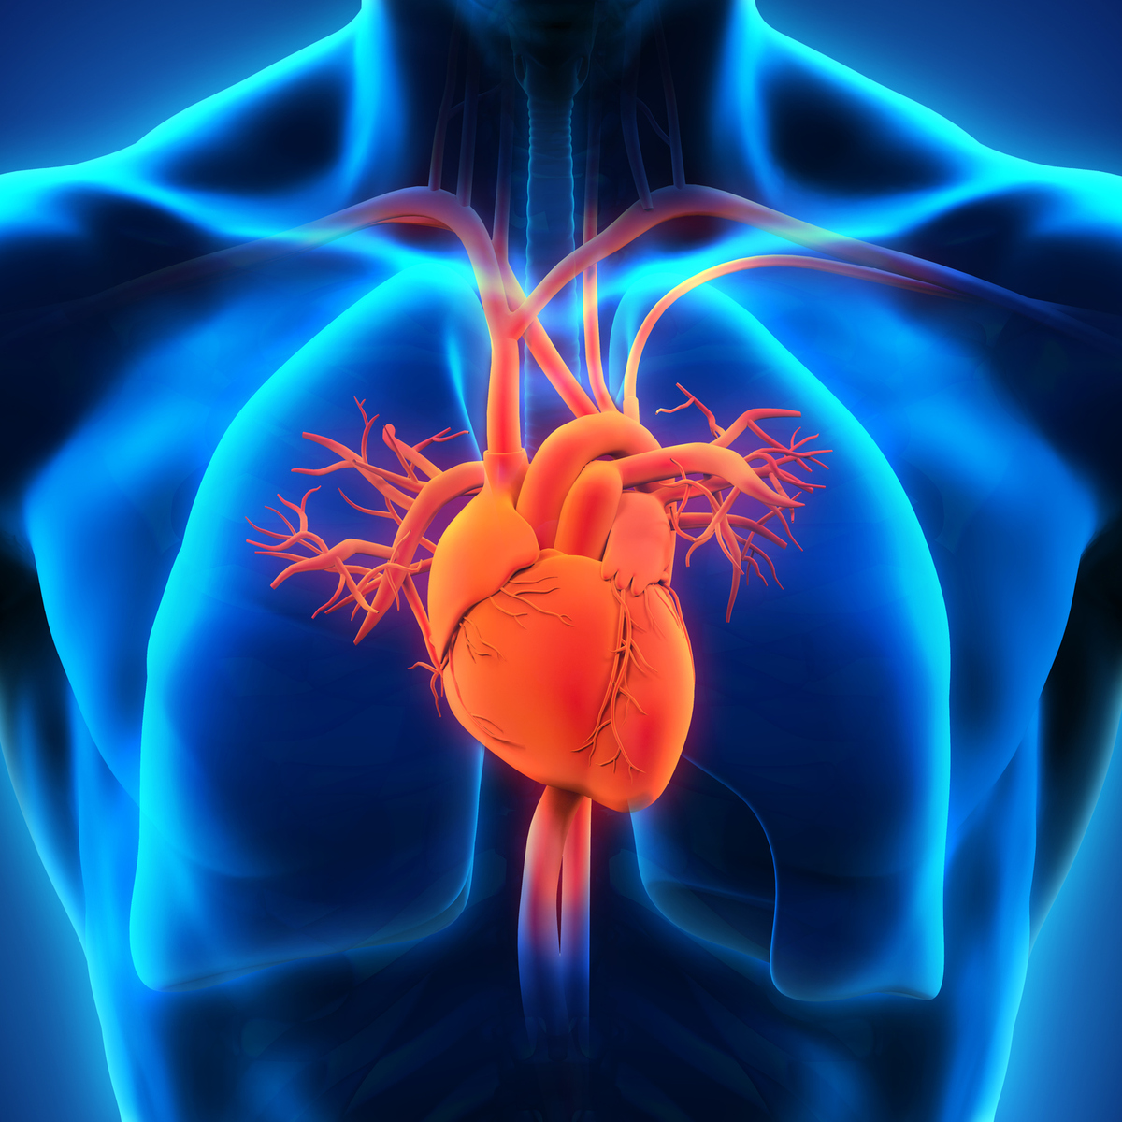
INTRODUCTION
Machine learning plays a crucial role in heart disease by enabling early detection, accurate diagnosis, and personalized treatment. It can analyse large amounts of patient data, including medical records, imaging tests, and genetic information, to identify patterns and predict the risk of developing heart disease.

Slide 4
abstract
Over the last decade heart disease is the main reason for death in the world. Almost one person dies of heart disease about every minute in India alone. In order to lower the number of deaths from heart diseases, there has to be a fast and efficient detection technique. Machine Learning algorithms and techniques have been applied to various medical datasets to automate the analysis of large and complex data. Many researchers, in recent times, have been using several machine learning techniques to help the health care industry and the professionals in the diagnosis of heart-related diseases. The main objective of this research project is to predict the heart disease of a patient using machine learning algorithms.

Slide 5
PROBLEM statement
The Main Objective of Developing this project is:
Predict whether a patient should be diagnosed with Heart Disease. This is a binary outcome.
Positive (+) = 1, patient diagnosed with Heart Disease.
Negative (-) = 0, patient not diagnosed with Heart Disease
Experiment with various Classification Models & see which yields greatest accuracy.
Examine trends & correlations within our data
Determine which features are most important to Positive/Negative Heart Disease diagnosis

Slide 6
Existing system
The system uses some medical parameters such as age, sex, blood pressure, cholesterol, and obesity etc., for prediction.
The Effective Heart Disease Prediction System (EHDPS) predicts the likelihood of patients getting heart disease. It enables significant knowledge, e.g., relationships between medical factors related to heart disease and patterns, to be established.
We have employed the multilayer perceptron neural network with backpropagation as the training algorithm.
The obtained results have illustrated that the designed diagnostic system can effectively predict the risk level of heart diseases.

Slide 7
PROPOSED system
In this system, the input details are obtained from the patient. Then from the user inputs, using ML techniques heart disease is analysed.
Now, the obtained results are compared with the results of existing models within the same domain and found to be improved.
The data of heart disease patients collected from the laboratory is used to discover patterns with
K - Nearest Neighbour.
Decision Tree.
Random Forest Classifier.
Logistic Regression.
The results are compared for performance and accuracy with these algorithms. The proposed hybrid method returns results of 87% for
F-measure, competing with the other existing methods

Slide 8
system REQUIREMENTS SPECIFICAION
Hardware System Configuration :
Software Configuration:
Libraries:
Processor : intel i3 or above.
RAM : 8(GB) and above.
Hard disk space: 64GB and above.
Operating System : Windows 10 / 11
Coding Language : Python
Editor : Jupyter Notebook,
Visual Studio Code
Pandas, Numpy, Matplotlib,
Seaborn, Scikit learn, pymysql etc..,

Slide 9
ARCHITECTURE
Input
Data Preprocessing
Machine Learning
Output
Dataset
Importing Medical Data
Model construction
Using
Multivariate
Logistic
Regression
Predict
The
Disease
Data Cleaning
Encoding Categorical Values
Splitting the Dataset
Data Reduction

Slide 10
UML DIAGRAM
Start
Patient Data
Extract Data
Classify Data
Match Symptoms
Analysis
Graphical Analysis
Disease Analysis
Disease Report
Yes
No
Save
Into the Database
End

Slide 11
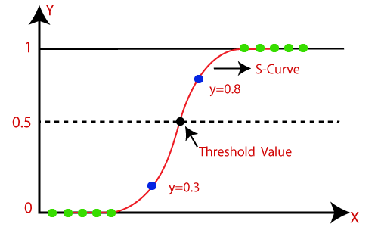
algorithms
Logistic Regression :
Logistic regression is one of the most popular Machine Learning algorithms, which comes under the Supervised Learning technique. It is used for predicting the categorical dependent variable using a given set of independent variables.
In Logistic regression, instead of fitting a regression line, we fit an "S" shaped logistic function, which predicts two maximum values (0 or 1).
Random Forest Classifier :
Random Forest is a supervised machine learning algorithm. This Technique can be used for both regression and classification tasks but generally performs better in classification tasks. As the name suggests, Random Forest technique considers multiple decision trees before giving an output. So, it is basically an ensemble of decision trees. This technique is based on the belief that a greater number of trees would converge to the right decision.

Slide 12
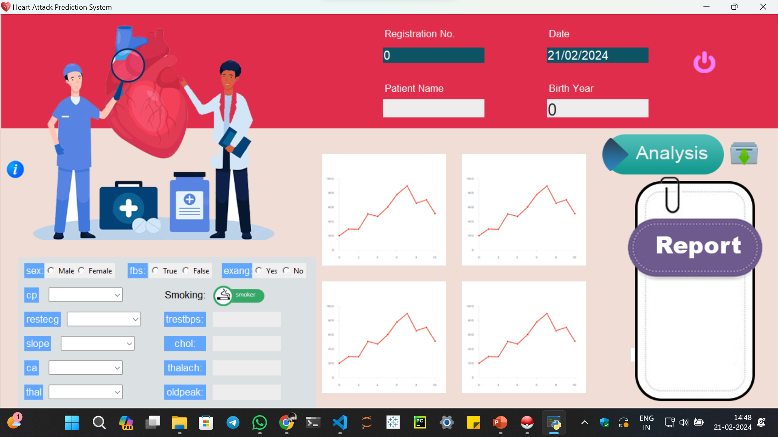
Screen shots
GUI for the Heart Disease Prediction

Slide 13
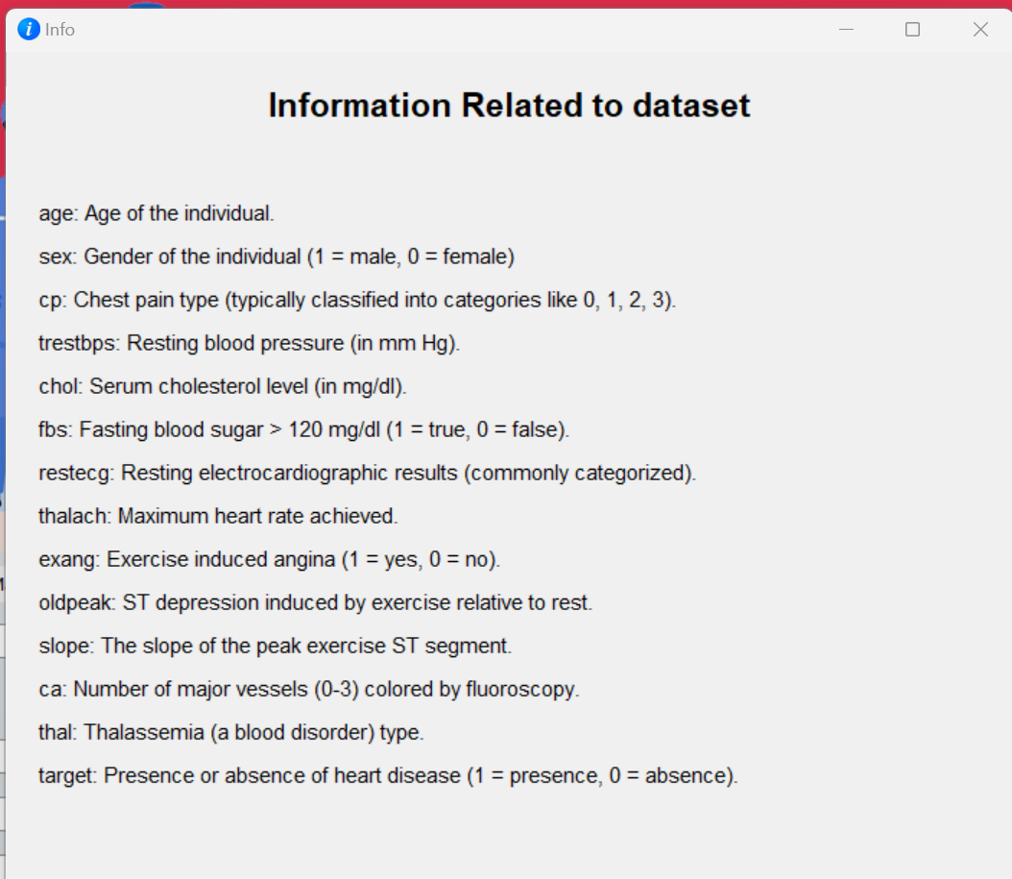
Information Related to Dataset.

Slide 14
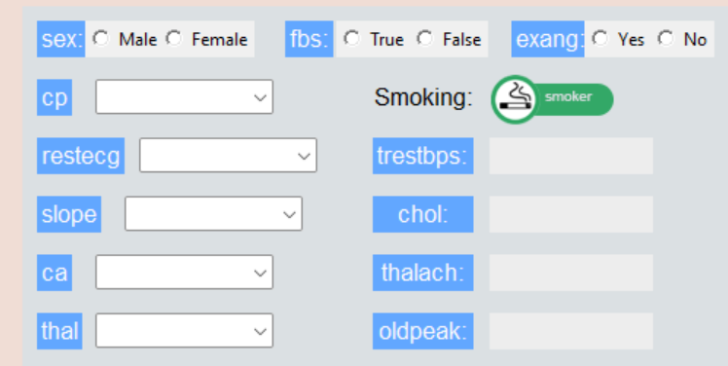
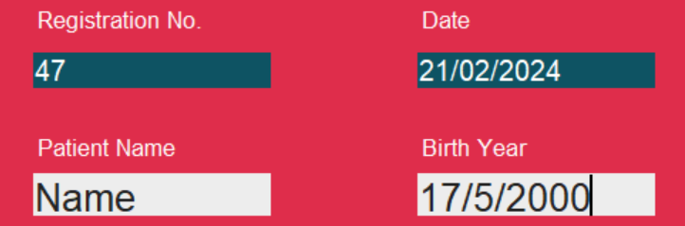
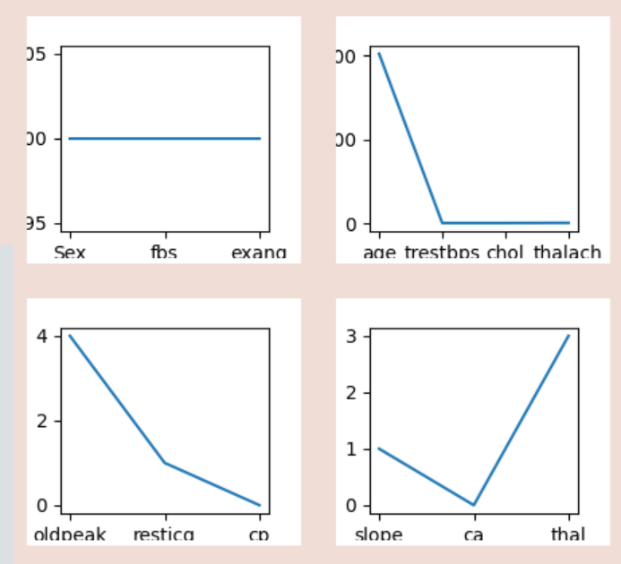

Report Details
Patient Details
Graphical Representation
Analysis
&
Report

Slide 15
Future enhancement
Feature Engineering:
Continuously refine and improve feature engineering techniques to better represent patterns indicative of Heart Disease Prediction.
Advanced Machine Learning:
Exploring the integration of advanced MLtechniques for enhanced detection accuracy
Continuous Model Evaluation:
Continuously evaluate the model's performance using metrics such as precision, recall, and F1-score, and refine it based on observed performance.
Real-Time Monitoring:
Implement real-time monitoring systems to analyze transactions as they occur and flag potentially fraudulent activities for immediate review.

Slide 16
conclusion
The main purpose of designing this system is to predict the risk of future heart disease. we have used Various Machine Learning algorithms to evaluate and train the model.
By this project we can conclude that we are predicting whether the person is diagnosed with Heart Disease or Not. This reduces the time to analyse the result and this saves the life of the Patient.
As technology advances, the seamless integration of machine learning predictions into existing healthcare systems holds the potential to usher in a new era of proactive and personalized cardiac care.
Early detection of potential cardiovascular risks allows for timely and targeted interventions, potentially mitigating the severity of heart diseases and improving overall patient outcomes.

Slide 17
References
https://www.irjet.net/archives/V7/i4/IRJET-V7I4993.pdf
https://www.heart.org/en/health-topics/consumer-healthcare/what-is-cardiovascular-disease
https://en.wikipedia.org/wiki/Cardiovascular_disease
https://www.kaggle.com/rishidamarla/heart-disease-prediction

Slide 18
Thank You
One and all …

